Slide 1
Number plate Detection and Recognition System
Team Members:
Vishnu vardhan reddy Manne
Sai Jaswanth Gattidi
Vandith Thotla

Slide 2
InTRODUCTION
The license plate recognition plays key role in automatic traffic monitoring and law enforcement of traffic. This system helps in identification of a vehicle entering into secured premises. So, license plate recognition system is very important for unattended parking lots, toll collection and in areas where security issues are very critical.
With increasing traffic on roads there is a need for efficient traffic management systems which not only detects and tracks a vehicle but identifies them using license plates.

Slide 3
Dataset Description
We took “Indian Number Plates” dataset for license plate recognition of the vehicles.
Source: https://dataturks.com/projects/devika.mishra/Indian_Number_plates.
The dataset contains two columns: Content and annotation
Content: It contains the Url’s for the vehicle’s images
Annotation: It contains label’s (License plate location points), image height and image width of the vehicles.
Labels will help us to get the License plate from the vehicle image.

Slide 4
System architecture
Vehicle Images
Number
Plates
Character Seg
and Recognition
Convolutional Neural Network
Input Layer
Max Pooling
Dropout
Flatten
Dense
Layer
Dense
Layer
Testing
Output

Slide 5
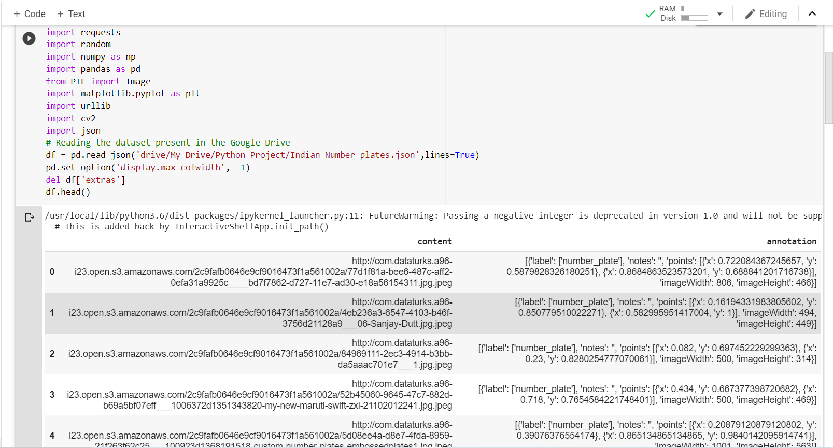
After connecting the Google drive with the Google Colab we have imported the required libraries, read the json file present in the Drive and deleted ‘extras’ field from the dataset and displayed the data frame object ‘df’.
APPROACH

Slide 6
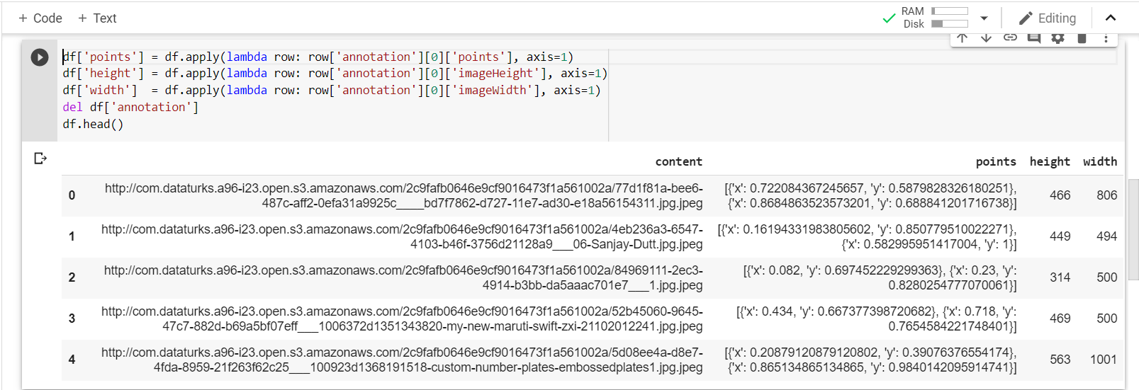
Then we have extracted License plate points, height and width of the vehicles from the annotation column.

Slide 7
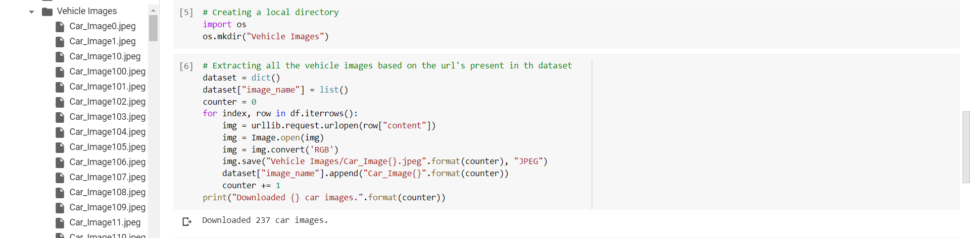
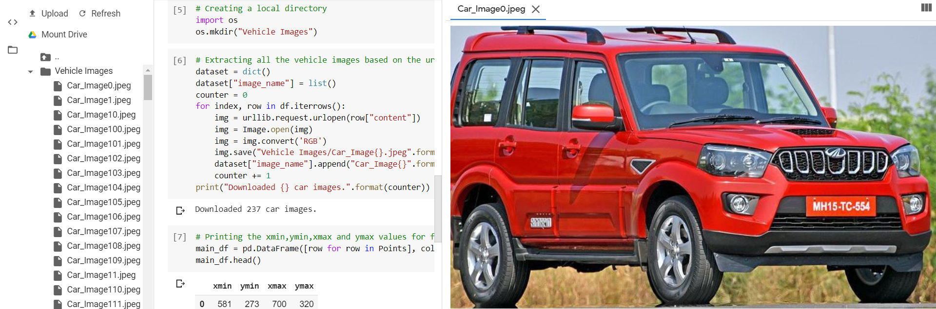
Then we have downloaded all the vehicle images by using the Url’s present in the ‘content’ column of the dataset. A directory ‘Vehicle images’ is created and all the images are stored in that directory.

Slide 8
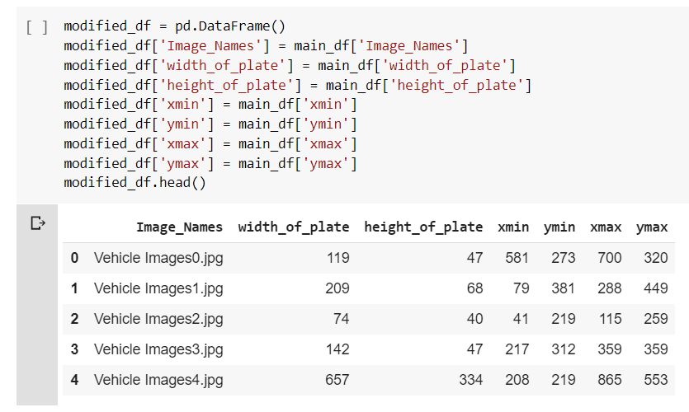
Finally we obtained a data frame object that contains all the required details for training the model and then to check how accurately the model is working.

Slide 9
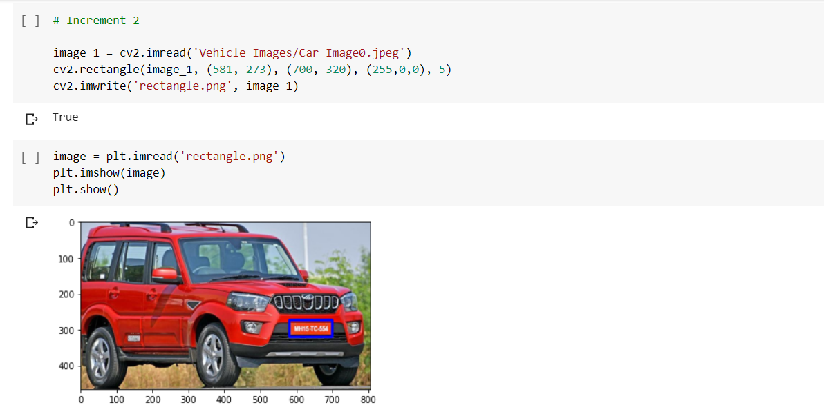
with the help of label point’s we have drawn a bounding box around the license plate on the vehicle image

Slide 10
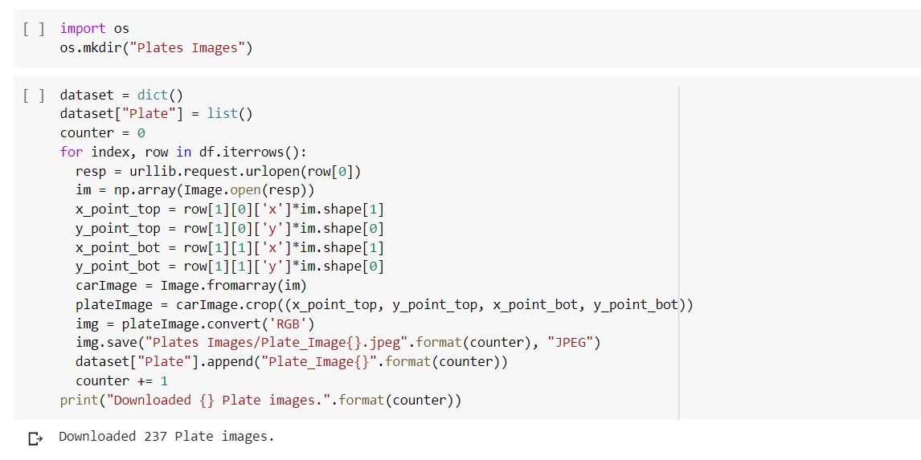
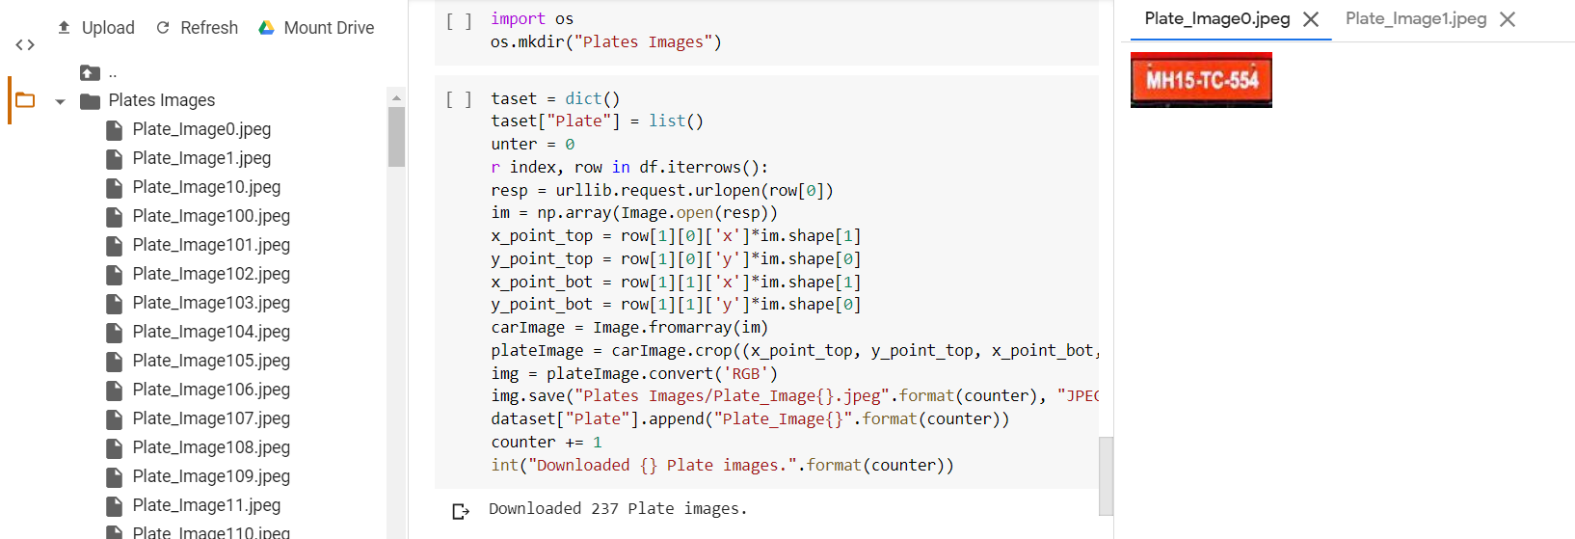
Then we have created a directory called ‘Plate Images’ and extracted all the license plate images from the vehicle images.

Slide 11
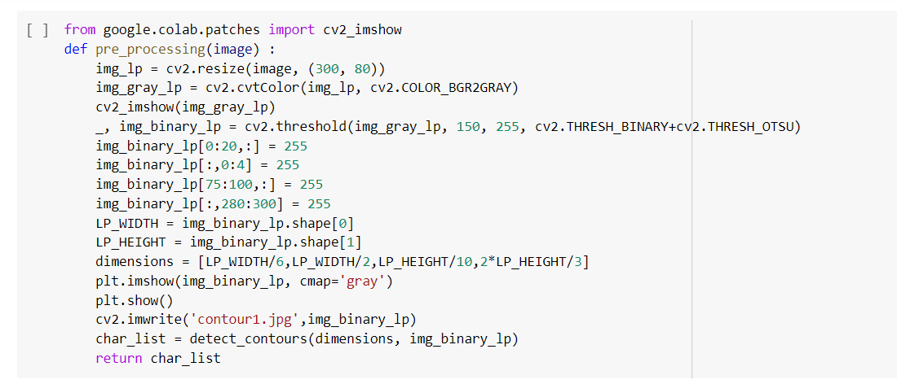
Character segmentation and Recognition
To make the character extraction easy we do some pre-processing to the extracted license plate image.
First, we adjust the dimension of the license plate by resizing it so that all the characters are clear.
Then we will convert the image to a grey scaled image having values ranging between 0 and 255. Here 0 indicates black and 255 indicates white color.

Slide 12
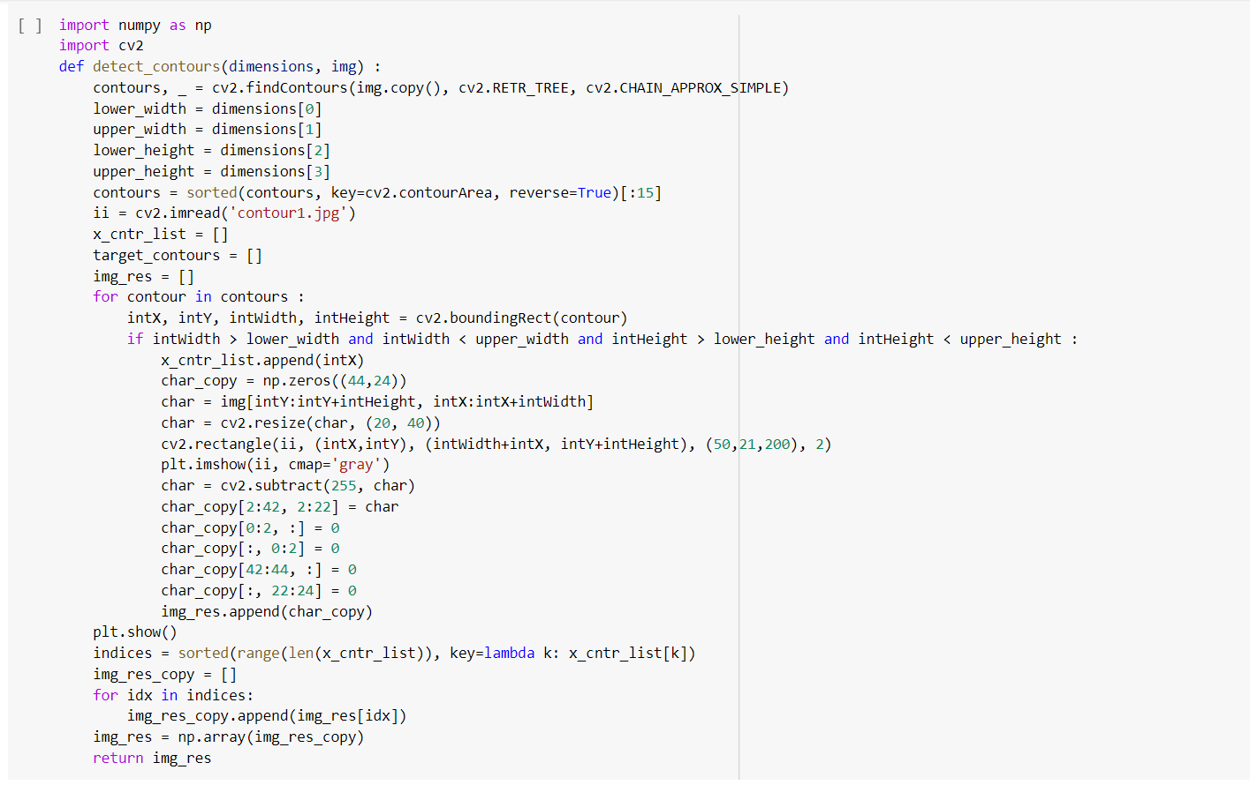
After processing the license plate we used cv2.findcontours to find the all the possible contours in the image. Then we have calculated the dimensions of the bounding rectangles and extracted the characters from the bounding rectangles.

Slide 13
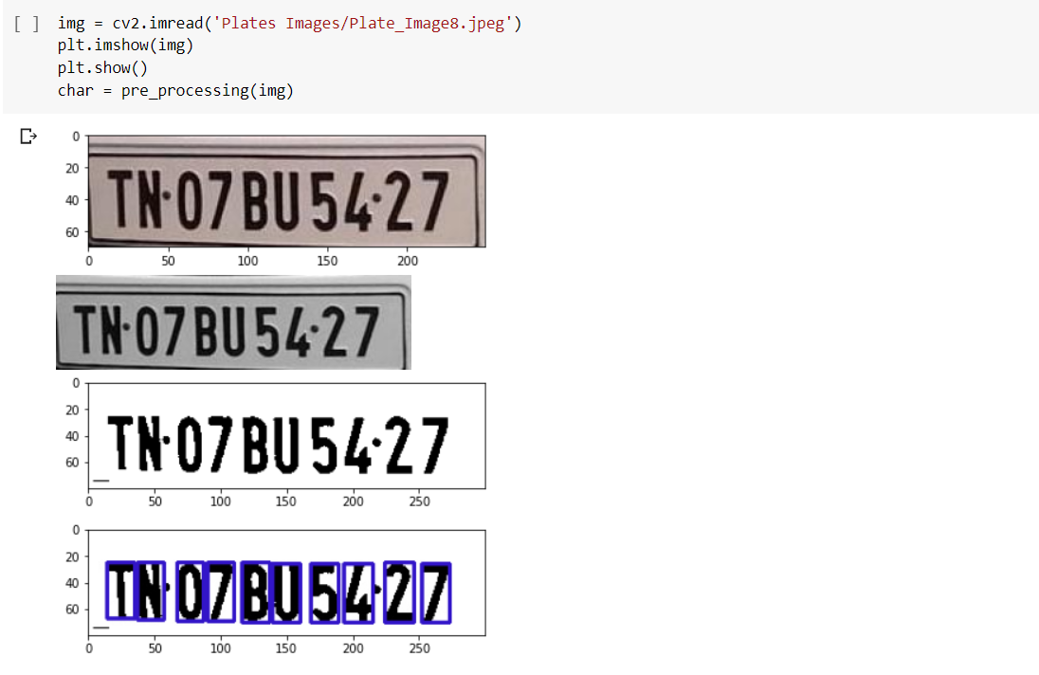
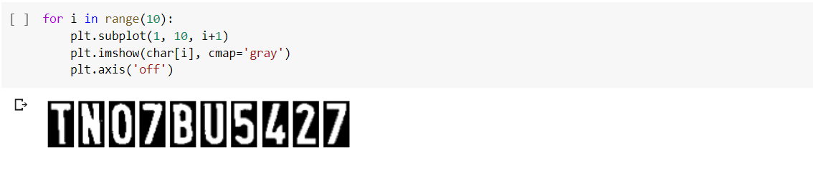

Slide 14
Convolutional neural network
Convolutional neural networks is generally used for analyzing visual images. They are also known as shift invariant or space invariant artificial neural networks.
We have created a convolutional neural network consisting of three layers to recognize the characters after training.
The model consist of a sequential object and consist of a convolutional layer with 32 output layers and Relu activation function.

Slide 15
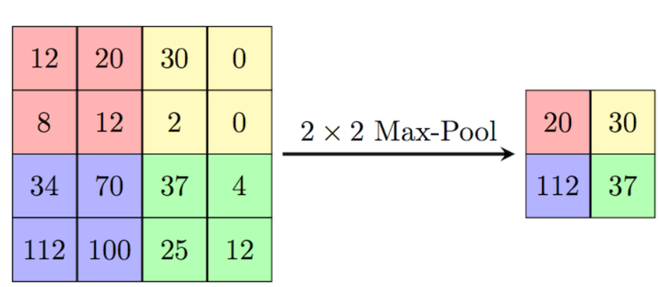
Then we have added a Max-pooling layer of window size (2,2). Max pooling will reduce the spatial size of the representation and it will also reduce the number of parameters and computation in the network. The Maxpooling will help preventing the model from overfitting.

Slide 16
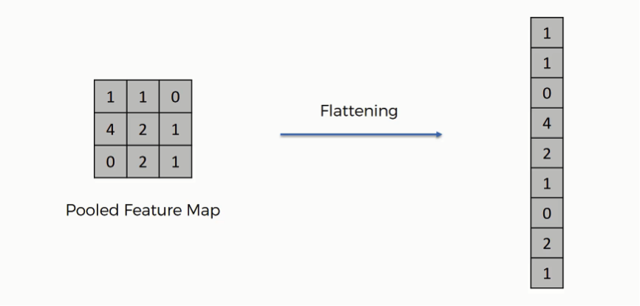
Then we have added a Dropout layer with a dropout rate of 0.4% which means only 60% of the data will be retained.
Dropout will prevent the neural networks from overfitting by ignoring the randomly selected neurons during the training.
Then we have flattened our data in which the data from the previous layer is taken and is converted into a single dimension data.

Slide 17
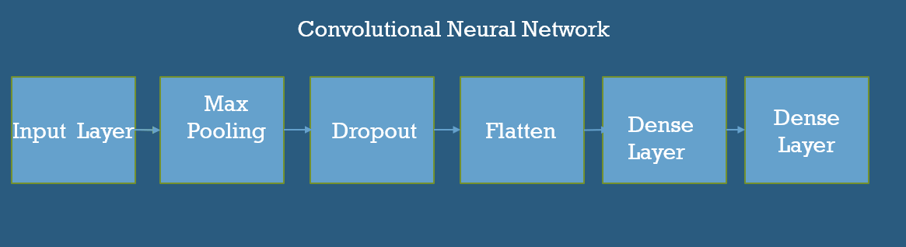
Then we have added 2 more dense layers one with activation function relu and other one with the activation function softmax. Here we are using softmax as the activation function because the output consist of more than two possible outcomes.

Slide 18
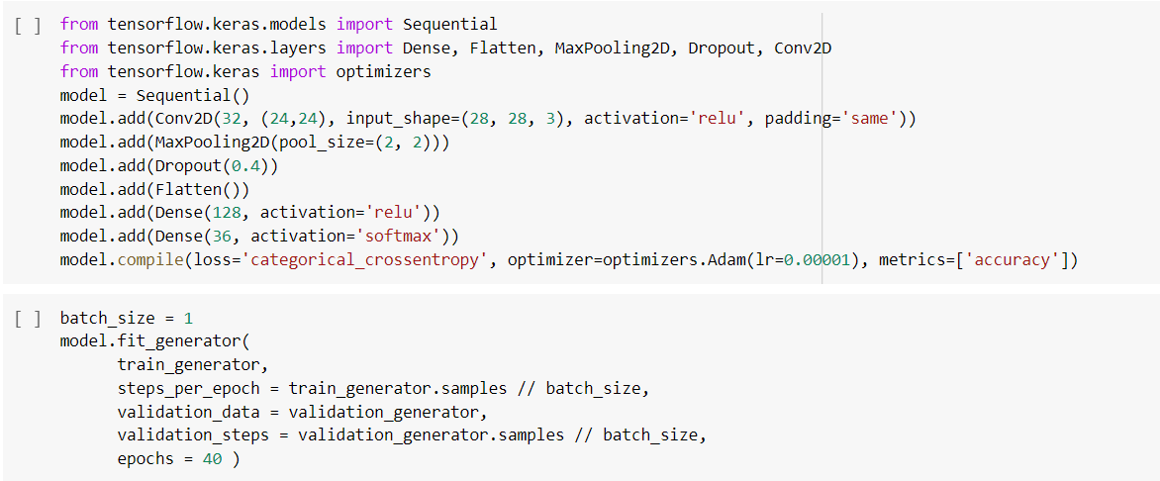
We have used categorical_crossentropy as the loss function and Adam as the optimization function.

Slide 19
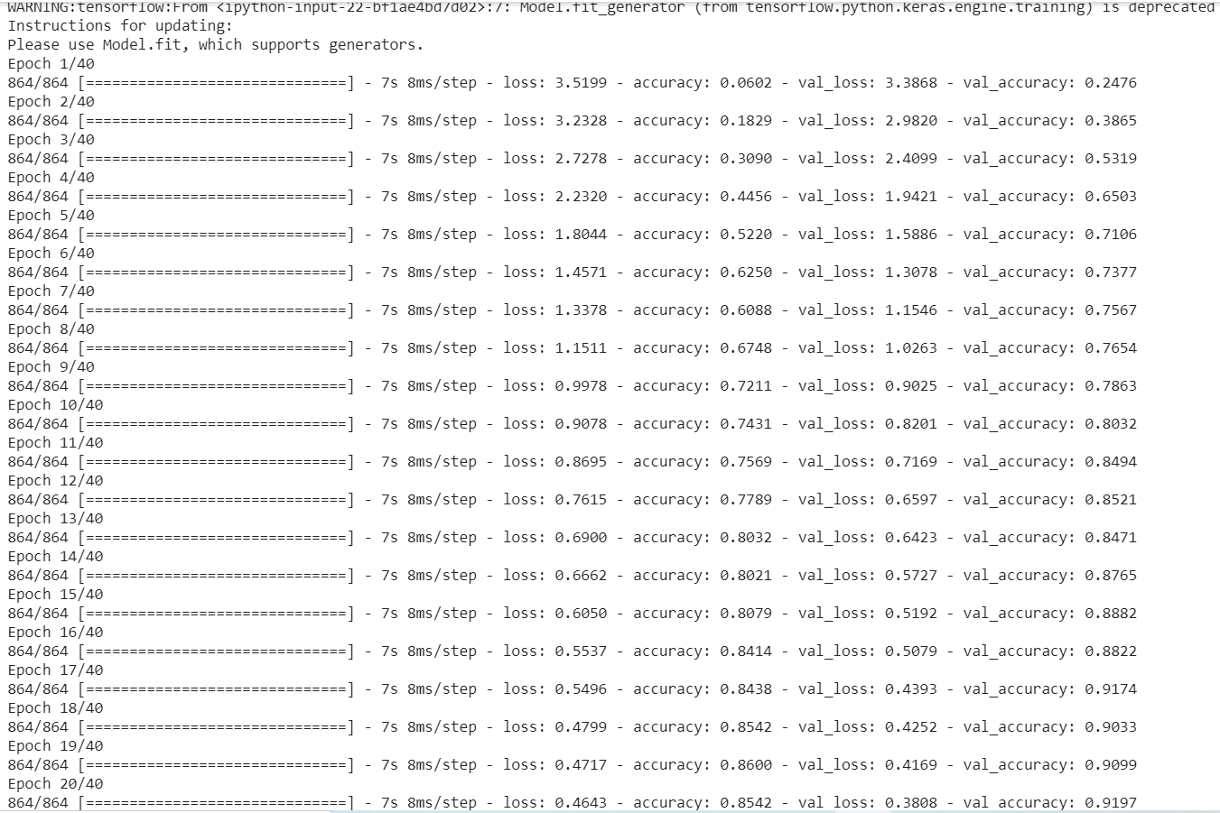
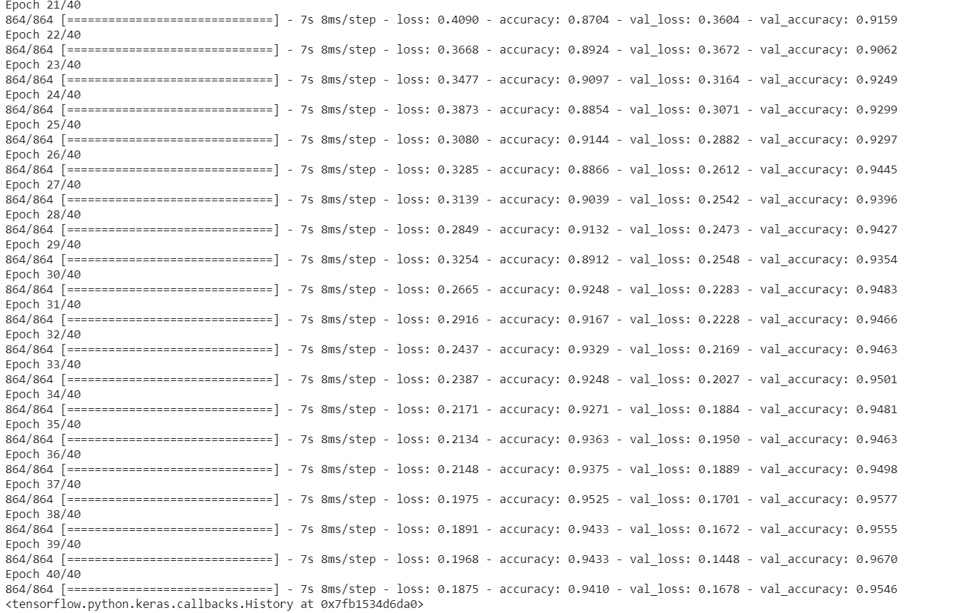
After training the model we got 94.10% accuracy and 95.46% as validation accuracy.

Slide 20
Image Data Generator
The image data generator has three methods to read the images from folders.
Here we will be using flow from directory for handling lot of images that will load images in the form of batches.
Here we are using image data generator to generate more data using image augmentation techniques.
We need to set the directory path and target size for the input images.

Slide 21
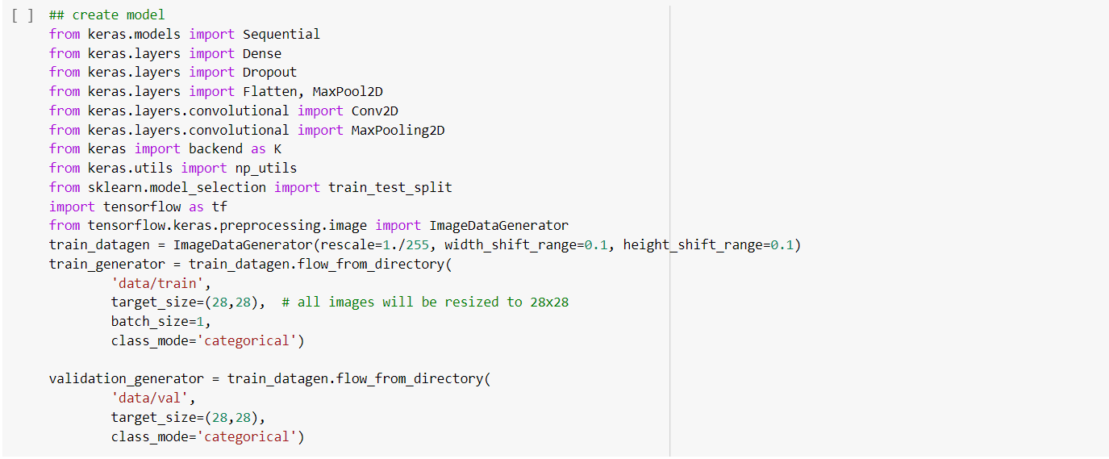

Slide 22
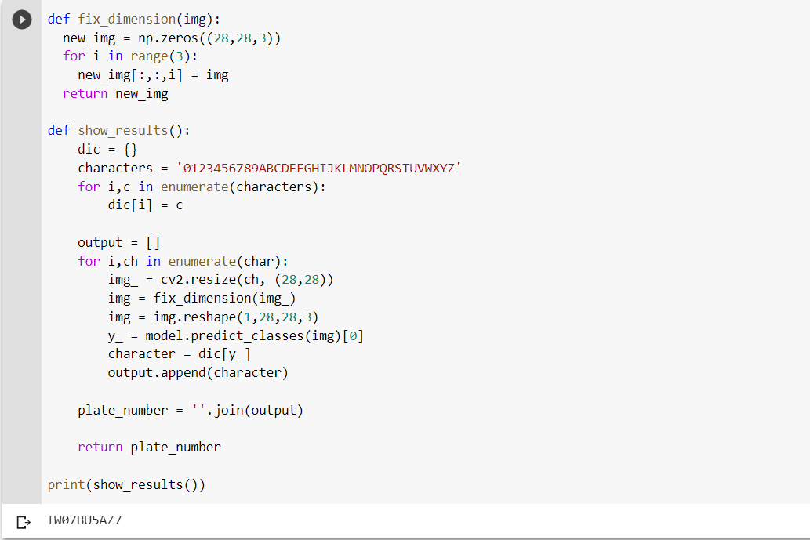
Testing the Model
Finally, for testing the model we have given the license plate image as input and iterated over the characters on the plate and stored the result into a list.

Slide 23
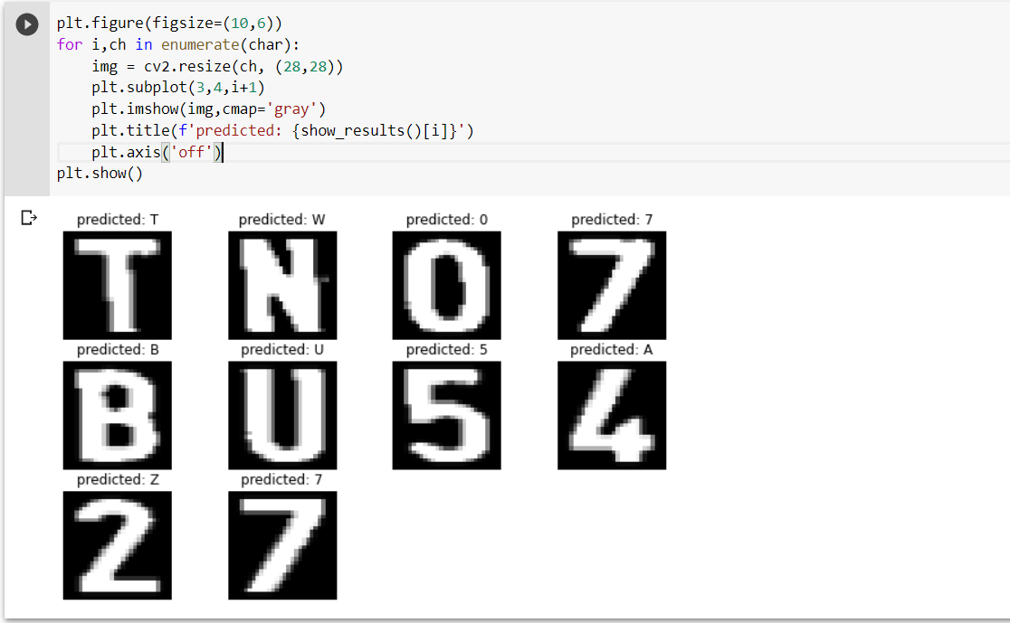
Image showing the prediction of the license plate characters.

Slide 24
Conclusion
We are able to extract the license plate from a vehicle image and performed character segmentation and recognition.
We have created a CNN model and predicted the characters on the license plate.

Slide 25


Thank You

